Slide 1
Linear Regression on LA AIRBNB Data
Alexander Vaillant

Slide 2
AGENDA
Introduction (Who am I?)
Problem & Hypotheses
Summary of Analysis Process
Findings
Limitations of Techniques & Tools
Proposed Actions
Expected Benefits

Slide 3
INTRODUCTION
Undergraduate Education: BMs in Music Education & Performance
Prior Experience: Assistant Administrator (Sports Media)
Prior Experience: Decision Support Analyst (Healthcare)
Current Position: Business Intelligence Analyst (Aviation)

Slide 4
Airbnb facts:
Over 32,000 Airbnb listings in Los Angeles, CA
LA considered one of the most popular Airbnb cities
Globally, over 14,000 new Airbnb hosts per month

Slide 5
What’s the Problem?
How can a new host successfully enter this popular market?

Slide 6
Hypotheses:
Alternate: A statistically significant model can be created to predict the Airbnb rental price.
Null: A statistically significant model cannot be created to predict the Airbnb rental price.

Slide 7
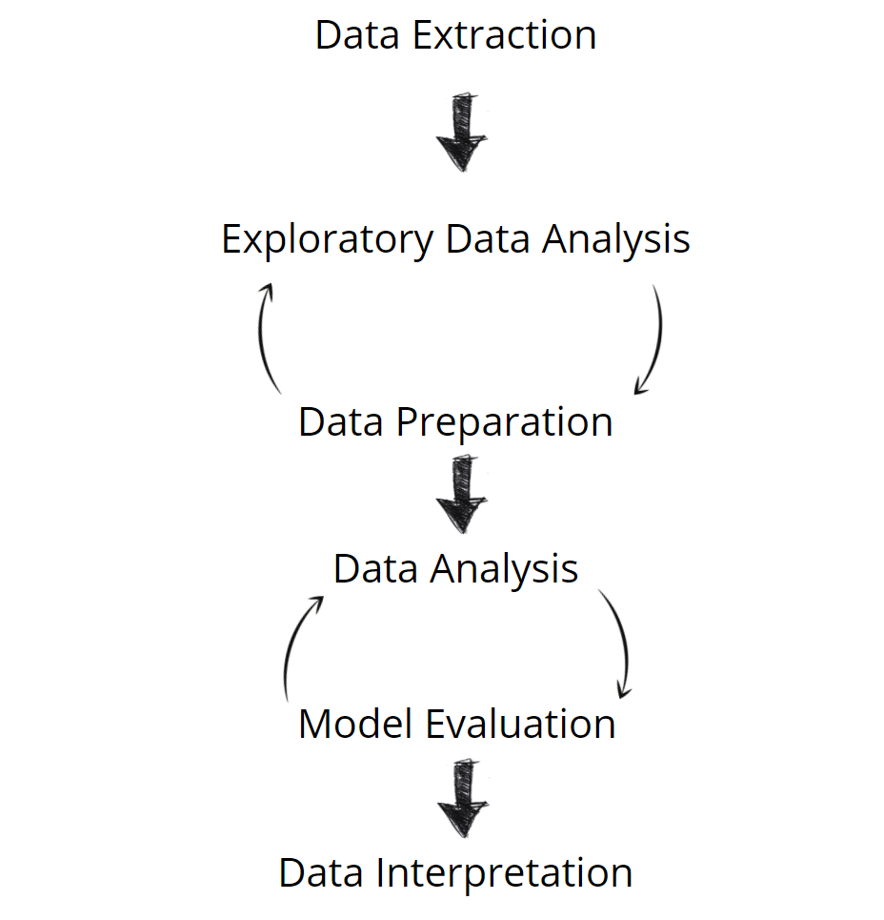
Summary of Analysis Process

Slide 8
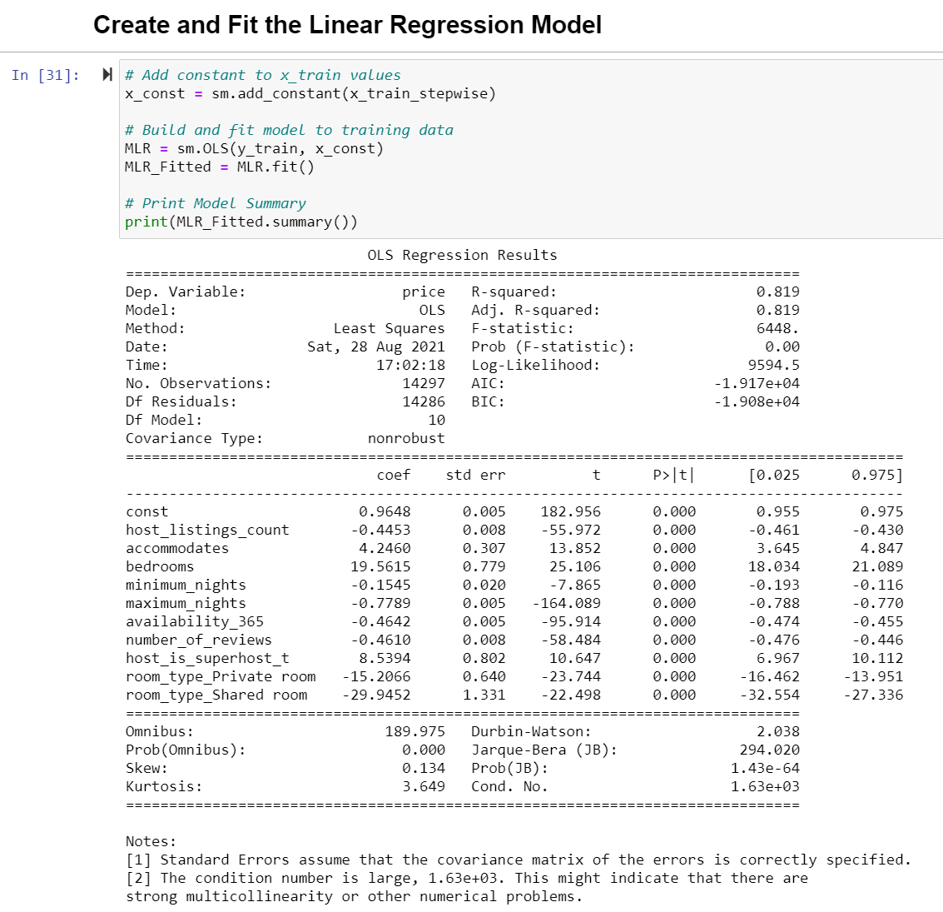
Outline of Findings
Statistically significant Model? Yes, P-values less than 0.05
Variables?
Number of Variables? 10
Statistically significant? Yes, P-values less than 0.05
Model’s explained variance of Price? Above 0.80 (80%)
Potential issues? Yes, Multicollinearity (highly correlated variables)

Slide 9
Limitations of Techniques & Tools
Can be affected by Multicollinearity
KNN Imputation
Can be computationally expensive
Scaling
Type depends on dataset
Multiple Linear Regression
Assumptions of data
Requires domain knowledge
Stepwise Regression
Variance Inflation Factor
Prone to Multicollinearity

Slide 10
Recommendation
Based on results, new Airbnb hosts should focus on:
Renting ENTIRE properties
Accommodating more people
Larger number of bedrooms
Becoming a Superhost:
90% Response Rate
1% Cancellation Rate
4.8 Overall Rating
Complete at least 10 trips

Slide 11
Proposals for Future study
Proposal #1
Proposal #2
Proposal #3
Use a Non-parametric Analysis Method that doesn’t make assumptions about the data
Use a different Feature/Variable Selection method on dataset
Explore the other neighborhoods in dataset

Slide 12
Expected Benefits
To MSDA program & Data Analytics Field?
A predictive model to gauge potential property’s affordability and revenue against competitors
To Business world?
With streamlined version of model:
Affordable monthly subscription service for use
How much do similar companies charge?
$100/month
With 1000 users, $100000/year for digital product
Reduce common, beginner host mistakes

Slide 13
THANK YOU
Alex Vaillant
VaillantAnalytics@gmail.com
www.linkedin.com/in/alexander-vaillant

